Slide 1

Article-Data Warehouse by- SHUBHAM CHAVAN
Data Warehouse Architecture
Introduction to DataWarehouse
What is Meta Data in Data Warehousing?
Examples Of Metadata
Types of Metadata in Data Warehousing

Slide 2
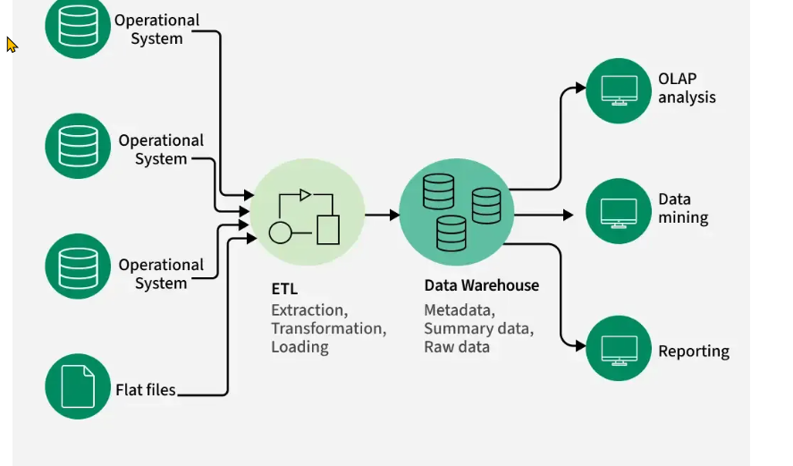
Data Warehouse Architecture

Slide 3

Data warehousing is the process of collecting, integrating, storing and managing data from multiple sources in a central repository. It enables organizations to organize large volumes of current and historical data for efficient querying, analysis and reporting.

Slide 4
What is Meta Data in Data Warehousing?
Metadata in data warehousing is data that describes other data. It provides information about the structure, meaning, origin, and usage of data stored in a data warehouse. Instead of containing actual business data, metadata acts as a guidebook that helps users and systems understand how data is organized and how it should be used.
For example: if a customer's purchase amount is the data, then the information about when the purchase was made, the data type, and the source system is its metadata.

Slide 5
Examples of Metadata
File metadata:
This includes information about a file, such as its name, size, type, and creation date.
Image metadata:
This includes information about an image, such as its resolution, color depth, and camera settings.
Music metadata:
This includes information about a piece of music, such as its title, artist, album, and genre.
Video metadata:
This includes information about a video, such as its length, resolution, and frame rate.
Document metadata:
This includes information about a document, such as its author, title, and creation date.
Database metadata:
This includes information about a database, such as its structure, tables, and fields.
Web metadata:
This includes information about a web page, such as its title, keywords, and description.

Slide 6
Types of Metadata in Data Warehousing
1. Business Metadata
Business metadata describes data in business-friendly terms so that non-technical users can understand it easily.
Examples:
Meaning of a column like Customer ID
Business rules for calculating "Total Sales"
Report definitions and KPIs
2. Technical Metadata
Technical metadata focuses on the physical and structural aspects of data.
Examples:
Table and column names
Data types (VARCHAR, INT, DATE, etc.)
Indexes, partitions, and storage locations
3. Operational Metadata
Operational metadata tracks process-related information about how data moves and changes.
Examples:
Data load timestamps
Error logs and refresh cycles

Slide 7


